Slide 1
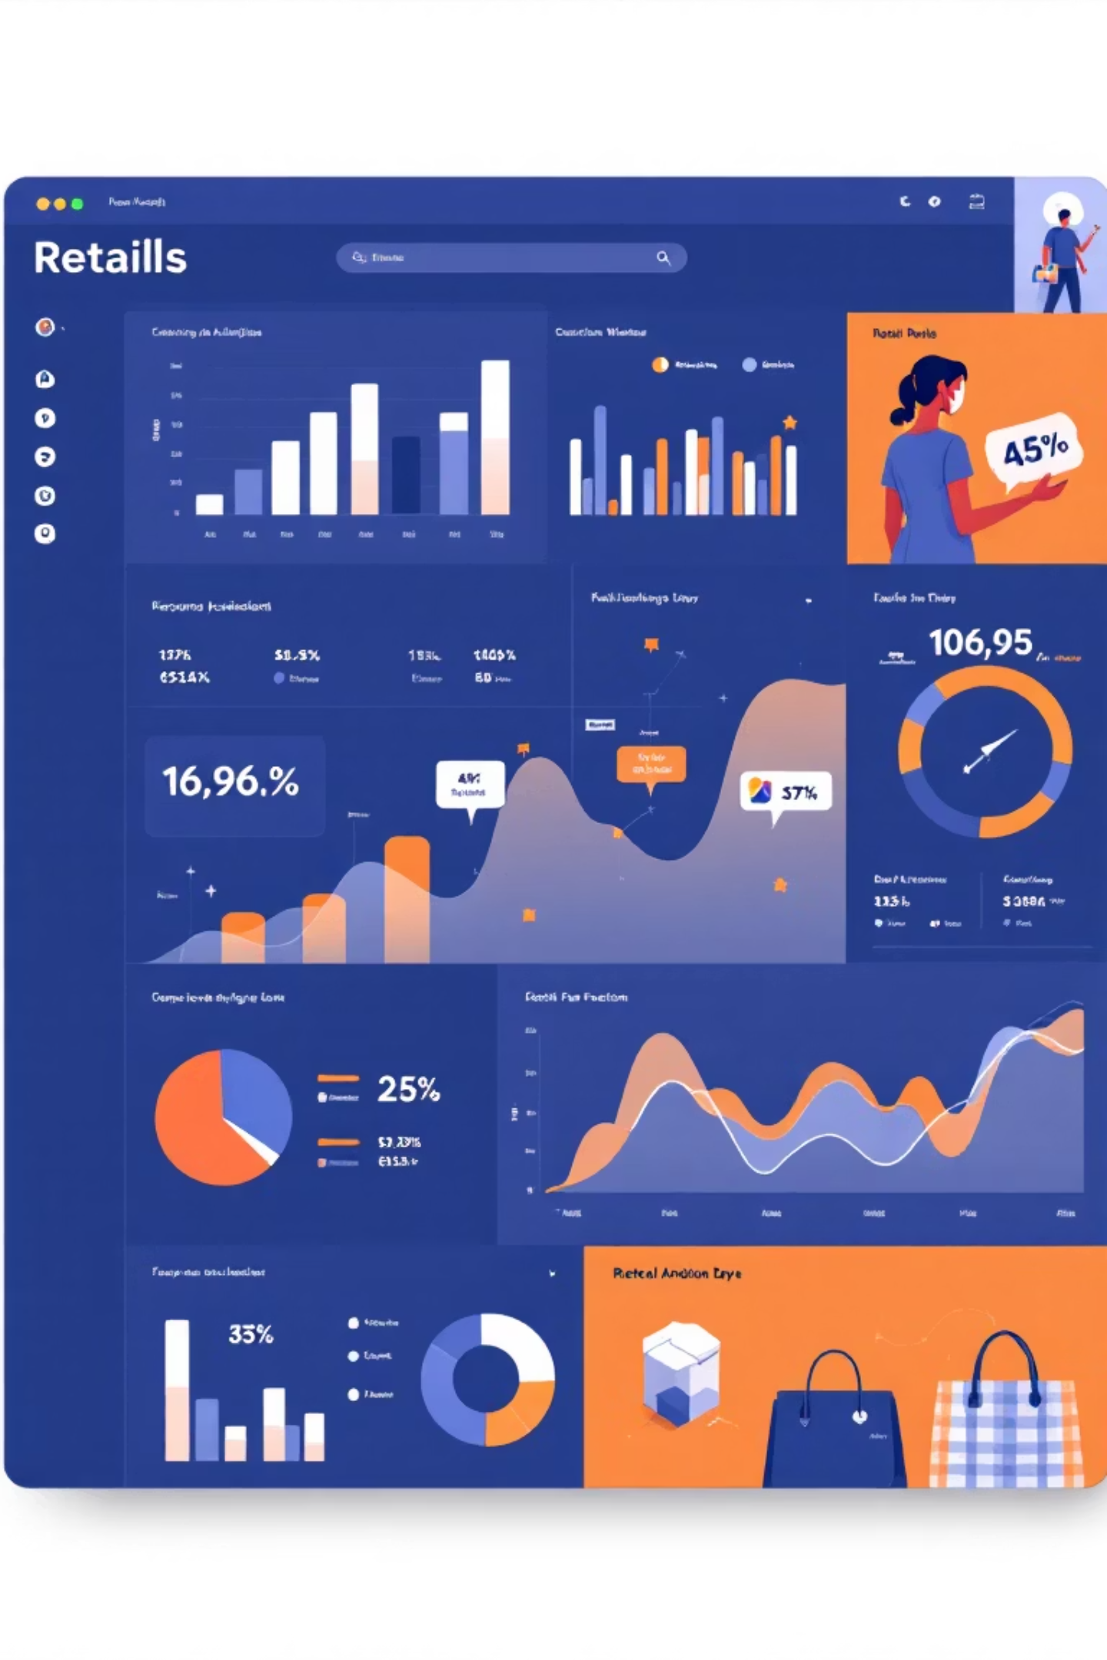
Customer Shopping Behavior Analysis
Uncovering insights from 3,900 purchases to drive strategic business decisions

Slide 2
Dataset Overview
3,900
18
37
Total Purchases
Data Points
Missing Values
Transnational data analyzed
Customer & purchase features
Review ratings imputed
Demographics
Shopping Behavior
Age, Gender, Location
Purchase patterns & frequency
Subscription Status
Discounts, ratings, shipping

Slide 3
Data Preparation Process
01
02
03
Data Loading & Exploration
Missing Data Handling
Feature Engineering
Imported dataset, checked structure and summary statistics
Imputed review ratings using median by category
Created age groups and purchase frequency metrics
04
05
Data Consistency
Database Integration
Standardized columns, removed redundant fields
Loaded cleaned data into PostgreSQL for analysis

Slide 4
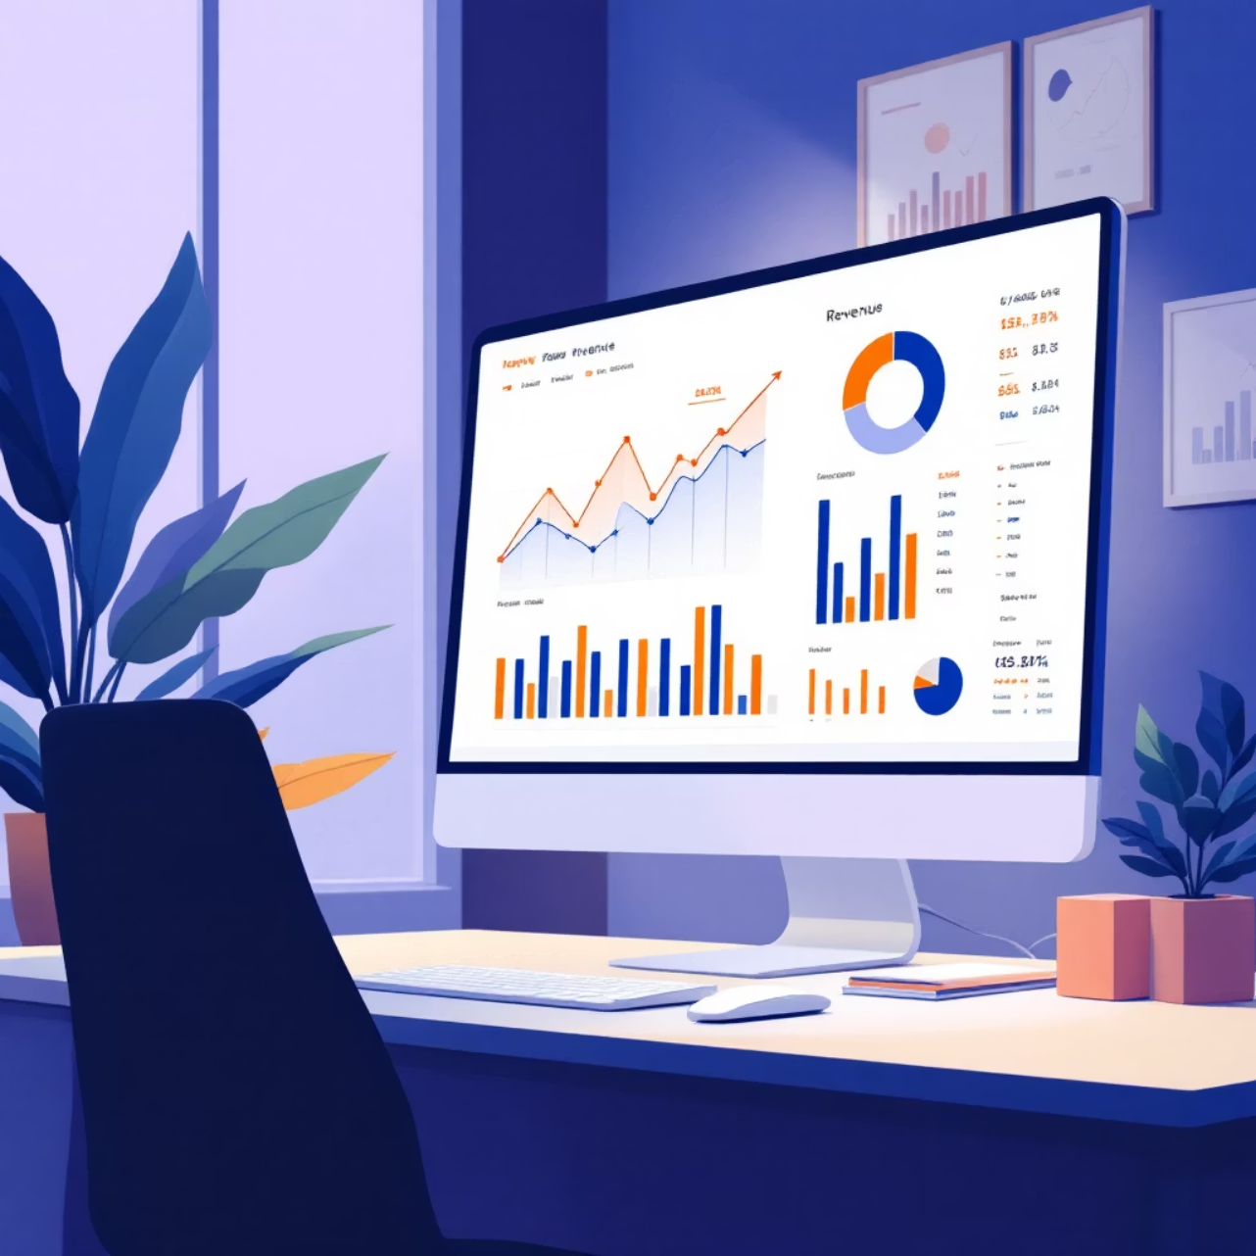
Revenue Insights
Gender Comparison
Male vs. female customer revenue analyzed
Age Group Revenue
Total contribution by demographic segment
High-Spending Discount Users
Customers using discounts but spending above average purchase amount

Slide 5
Product Performance
Top 5 Products by Rating
Top 3 Per Category
Discount-Dependent Products
Highest average customer review ratings identified
Most purchased items within each product category
5 products with highest percentage of discounted purchases

Slide 6

Shipping & Purchase Behavior
Standard Shipping
Average purchase amount compared across shipping types
Express Shipping
Higher spending patterns observed with faster delivery

Slide 7




Customer Segmentation
Returning Customers
Moderate purchase history and engagement
New Customers
First-time purchasers entering the funnel
Loyal Customers
High-frequency buyers with strong brand affinity
Classification based on purchase history and frequency patterns

Slide 8


Subscription Analysis
Subscribers vs. Non-Subscribers
Repeat Buyers & Subscriptions
Average spend and total revenue comparison
Customers with >5 purchases show higher subscription likelihood

Slide 9
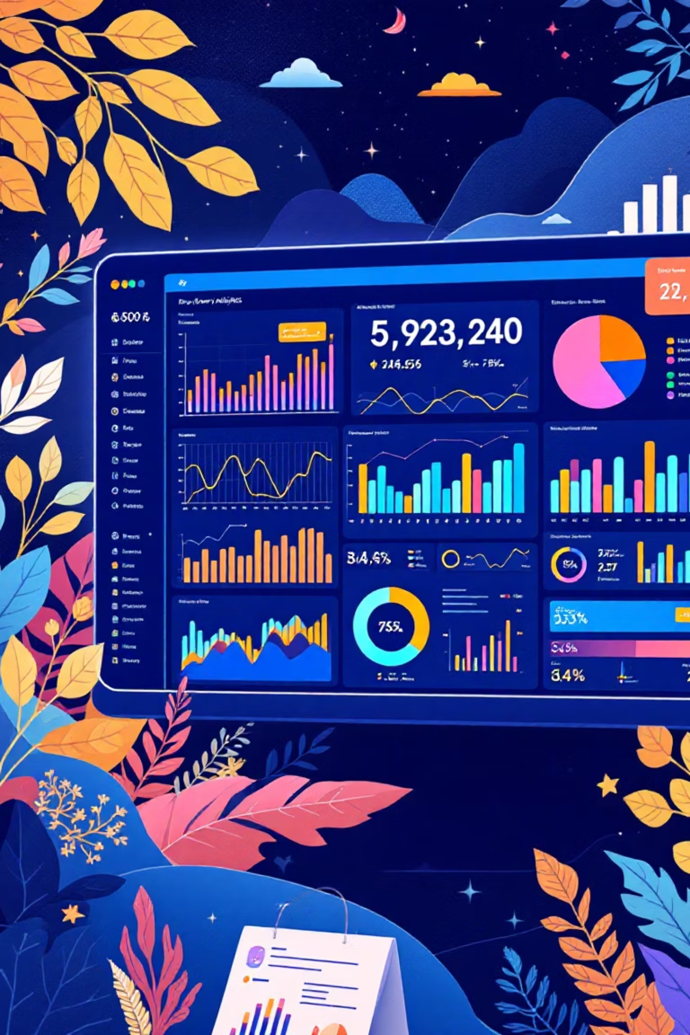
Interactive Dashboard
Power BI visualization presenting key insights and trends
Real-time Metrics
Revenue, customer segments, product performance
Interactive Filters
Drill down by category, demographics, time period
Visual Insights
Clear patterns for strategic decision-making

Slide 10
Strategic Recommendations
Boost Subscriptions
Loyalty Programs
Review Discount Policy
Promote exclusive benefits for subscribers
Reward repeat buyers to increase retention
Balance sales boosts with margin control
Targeted Marketing
Product Positioning
Focus on high-revenue segments and express shipping users
Highlight top-rated and best-selling items in campaigns

